Slide 1



Fully Scalable ML in SQL with Python
Presented by Samer Salameh
Notes:
https://www.forbes.com/sites/oracle/2019/09/03/how-dbas-can-get-data-science-cred-fast/#11baf3d770a5
Machine Learning is in your database, its about data , being a DBA will increase the chance of understanding and practicing AI.
Since you are more familiar about data, manipulating the data, exploring it, detecting outlier,…
Together will explore the power of SQL and act like a pro dba.
Data is DBA baby, he’s the closet person to it,
Is there a dba ?
How many time whenever someone ask you a report u start directly select * ….
Its like telling a football fan to play he directly go change his clothe to play
At the end of each section I will allow a couple of questions and we will have full Q&A and the end
Hands on who used sql before
Hands on who never used a sql

Slide 2
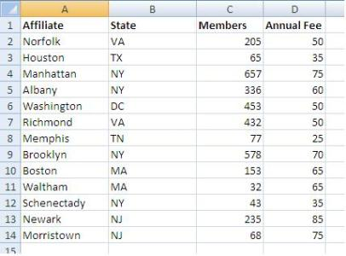
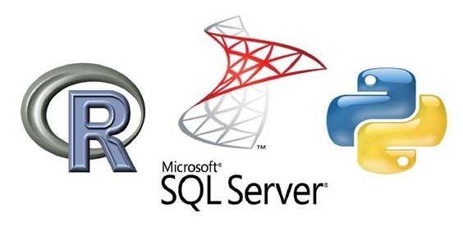


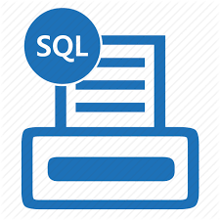

Workshop Outline
Introduction Data Science
Preparing SQL Server Environment
What is SQL?
SQL Server Management Studio
Preparing to write SQL
Machine Learning Services in SQL
Practical use cases
Notes:
We will have a brief introduction about SQL, what is SQL and why using it
Will show how SQL has been improved into the last 10 years into going into big data
Will understand what is relational database and how data was collected before
Will prepare the environment
We will also explore the main tool of SQL, the ssms, from admin perspective
Then we will write query and explore out database and retrieve insert data , Data wrangling, sometimes referred to as data munging
And the part that you are all waiting for it, the machine learning services
Why do I need to have to run python or R in sql ? Practical use case
Will have demo or running machine learning service
Will explore finally the data mining in Sql Server Integration service
SQL Server Integration Services (SSIS) is a component of the Microsoft SQL Server database software that can be used to perform a broad range of data migration tasks. SSIS is a platform for data integration and workflow applications.

Slide 3
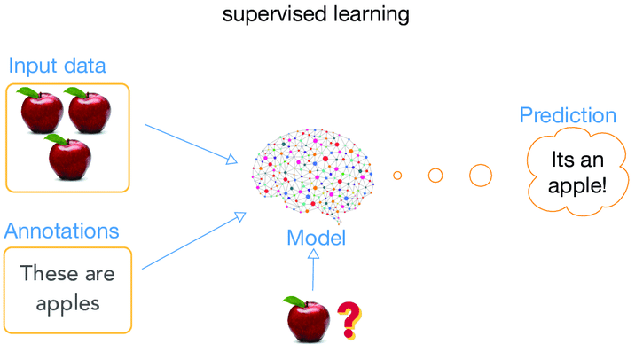
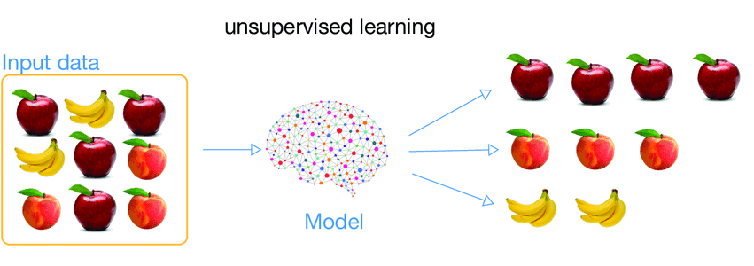
Types of Machine Learning
Supervised learning
Output labels are known
Learn the ML model that produces the prediction closest to the output
Unsupervised Learning
Output labels are not known
Divides data into clusters of similar data points

Slide 4
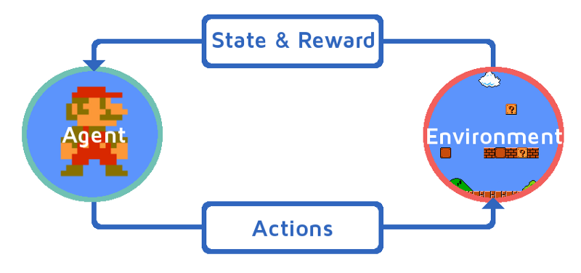
Types of Machine Learning
Reinforcement Learning
An agent interacts with an environment and performs action
Learns through experience (reward mechanism)

Slide 5
Jupyter Notebook
Open-source web application
To create and share documents that contain live code,equations,visualizations and narrative text.
Uses include
data cleaning and transformation
numerical simulation
statistical modeling
data visualization
machine learning
and much more

Slide 6
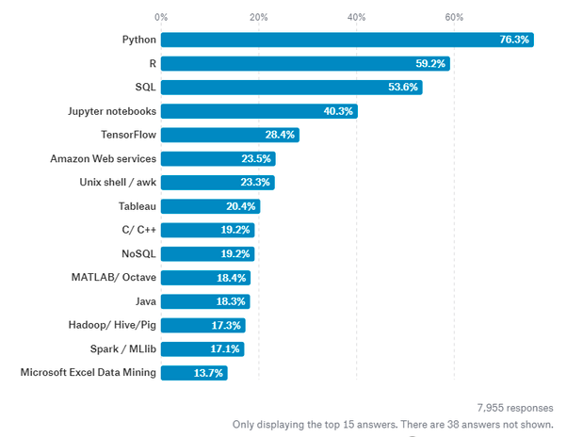
Top Data Science Technologies
Notes:
https://www.google.com/url?sa=i&source=images&cd=&cad=rja&uact=8&ved=2ahUKEwjgvvjrgZXlAhUJ1hoKHZU2DTIQjRx6BAgBEAQ&url=https%3A%2F%2Fwww.thinkful.com%2Fblog%2Finsights-on-the-data-science-job-market-analyzing-7k-data-science-job-descriptions%2F&psig=AOvVaw2Xk68_T3rkbkXqIuIR90Bi&ust=1570911040283830

Slide 7
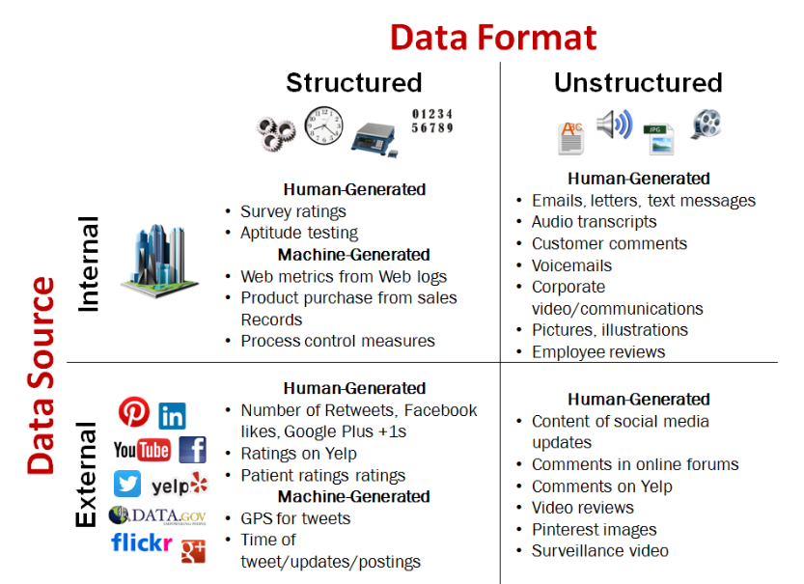
Data Definition Framework

Slide 8
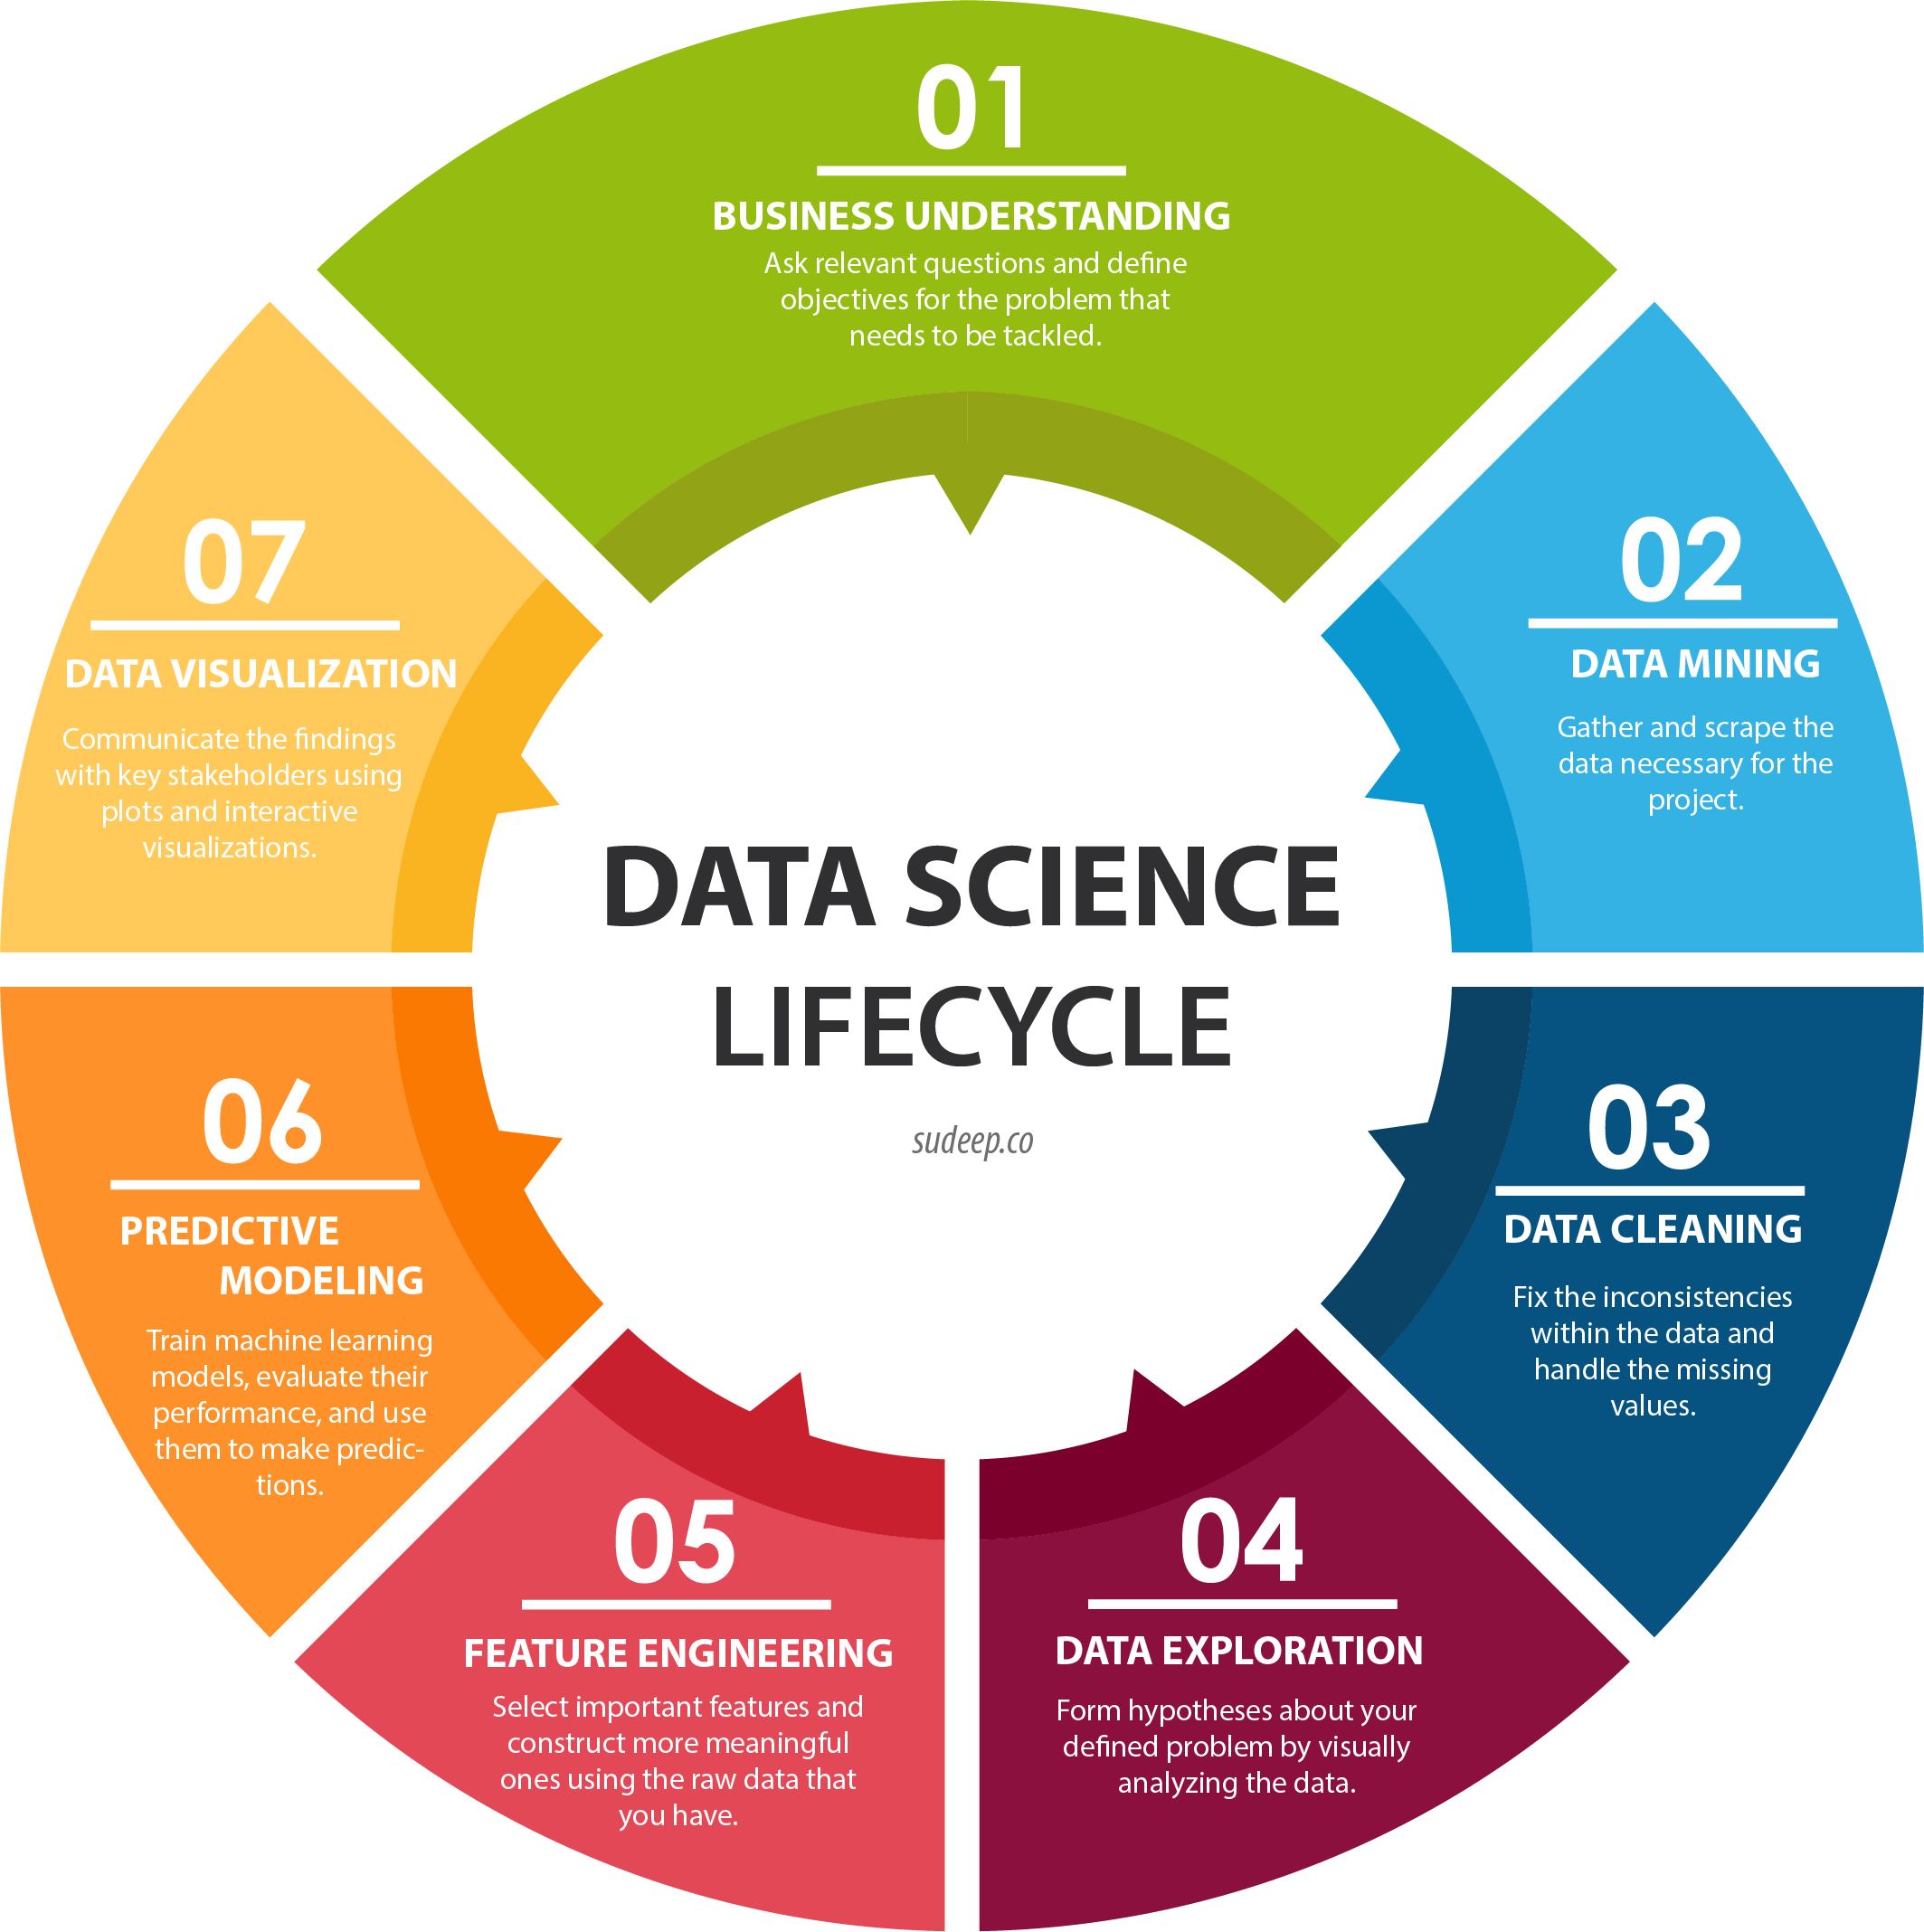
Data Science Life Cycle

Slide 9


Slide 10
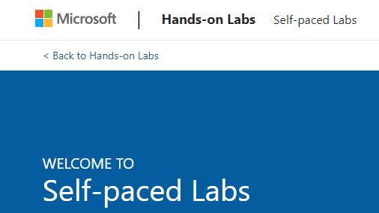
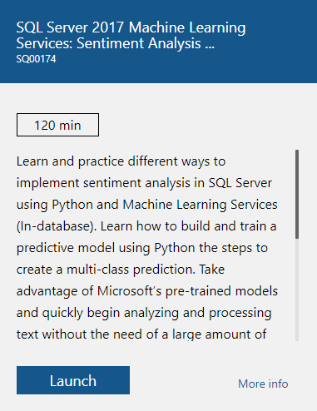
Preparing the Environment
https://www.microsoft.com/handsonlabs/selfpacedlabs

Slide 11
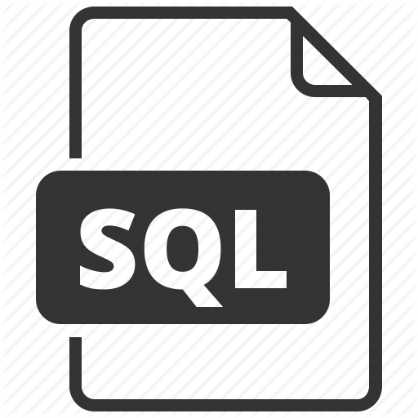



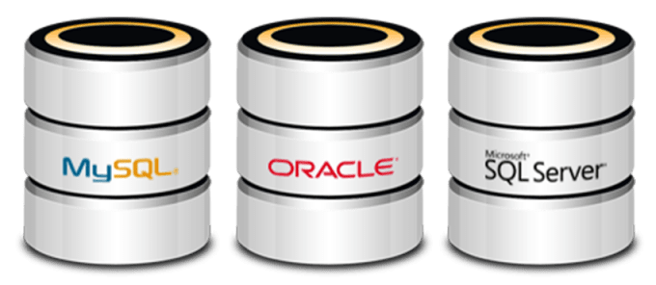
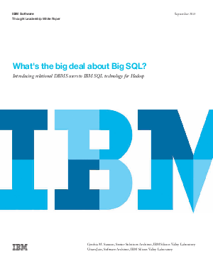
What is SQL
Structured Query Language
Storage
Access and manipulate
Target
Developed by
Like All relational database management system
Notes:
SQL syntax and MSSQL are related but distinct. SQL syntax is the language used to query databases, and MSSQL is the Microsoft database product suite which uses SQL syntax.
https://blog.sqlizer.io/posts/sql-43/
khkhk
https://www.google.com/imgres?imgurl=https%3A%2F%2Fimage.slidesharecdn.com%2Fsqlserver-160406091219%2F95%2Fwhat-is-sql-server-2-638.jpg%3Fcb%3D1463133949&imgrefurl=https%3A%2F%2Fwww.slideshare.net%2Fcpdindia2%2Fsql-server-60550586&docid=IE6DT03bf0uQkM&tbnid=V70Rv0EKekZ8TM%3A&vet=10ahUKEwiQwZH6stjkAhXp0eAKHeKRCqoQMwhkKAcwBw..i&w=638&h=359&bih=937&biw=1920&q=What%20is%20MSSQL&ved=0ahUKEwiQwZH6stjkAhXp0eAKHeKRCqoQMwhkKAcwBw&iact=mrc&uact=8
https://www.atlantic.net/what-is-mssql/

Slide 12
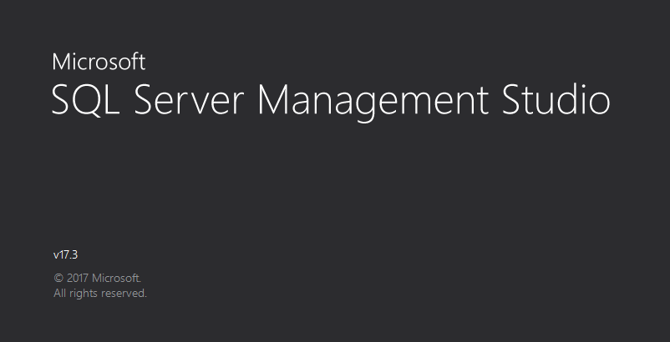
SQL Server Management Studio (SSMS)
SQL Server Management Studio (SSMS) is a powerful graphical DB management tool
Administrate databases (create, modify, backup / restore DB)
Create and modify Entity Relationship (E/R) diagrams
View / modify table data and other DB objects
Execute SQL queries
Free and easy to use tool
Works with all SQL Server versions
And much more
Notes:
https://www.atlantic.net/what-is-mssql/
https://en.wikipedia.org/wiki/SQL
https://www.quora.com/Who-developed-SQL

Slide 13

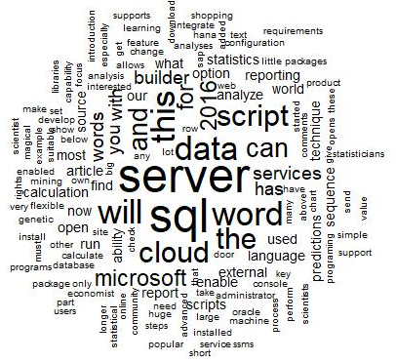
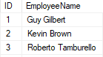

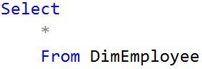
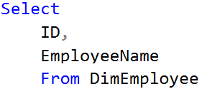
Preparing to write SQL
Easy to learn
Result
Basic command Vocabulary less than 100 words
Several SQL
dialects exist
Notes:
SQL is relatively easy to learn
Basic command set has vocabulary of less than 100 words
Nonprocedural language
American National Standards Institute (ANSI) prescribes a standard SQL
Several SQL dialects exist

Slide 14

What SQL can Do?
SQL

Slide 15

Machine Learning Already in Your Database
Open database
Think about use case
Define business problems
Extract , Transform, Load (ETL)
Data wrangling
Production scripts
Notes:
To get started, DBAs will simply open the autonomous database service console where a DBA will see common data management options for downloading clients or setting passwords, and so on. But they’ll also see a machine learning link called: Oracle ML Users. “And you click on it and now you’re going down a different hallway to the land where the data scientist people hang out,” Berger says.
The DBA will find a data science notebook where they can define business problems, gather and prepare data, and apply machine learning algorithms available from an extensive library. Next, the DBA can use a simple Zeppelin notebook user interface to build and test machine learning models. Much of the work will be familiar to database experts. “Database developers perform many of these tasks already,” Berger says, “but they refer to them as ETL, data wrangling, and production scripts.”
When going into the machine learning section, raise their concerns before they ask, why I need to use python into SQL, what’s the benefit:
Why should I use python in SQL?
Is it SQL in python? I could use SQL alchemy and query the database? Why I need to learn or explore something new
Yes its python in SQL, executing external script
How to deploy your machine learning project? I need to learn a flask? API?
Why not just put the code inside SQL and run it since data is already there
Can create .net application for example and run
Someone can say, ok I am a python developer why I should learn SQL, I can import it through SQL alchemy and analyze it. And this is the second benefit? Scalability, u have 100GB of database, loading it into your Jupyter notebook and analyze it, I will blow your machine RAM/CPU for playing around the data
The data if it’s truly SQL, can’t be copy, can’t analyze data efficiently
The data if is truly SQL quality, the data can’t be copy out of SQL, can’t analyze it efficiently outside SQL, because you need to copy it piece by piece, the hall points of big data can’t look of peace by pc this is Hadoop, been able to inject python into SQL library it’s very important, because in SQL alchemy the script is not scalable for billions of data points, if learn I am a python developer and I learned little of SQL, I can explode my python extension by making inside SQL for speed concerns, rapidly deployed on billions of data point and point 2 its more efficient speed-wise, database talk to itself
Speed & Inaccessibility
Demo running python scripts inside SQL

Slide 16
Data Engineering
Notes:
https://www.google.com/search?rlz=1C1CHBF_enLB766LB766&biw=1920&bih=937&tbm=isch&sxsrf=ACYBGNSM7ln_2XVFs9nxdkYizXLgA_uFvQ%3A1567720951135&sa=1&ei=94VxXf70B4rEgQazwJ2oBg&q=dba+icon&oq=dba+ico&gs_l=img.3.0.0.110663.112391..114221...1.0..0.170.1256.0j8......0....1..gws-wiz-img.......35i39j0i67j0i24.oo0UdZr6Bn0#imgrc=_

Slide 17
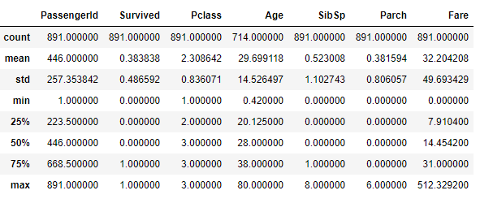
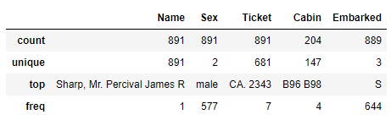
Descriptive Data
Passengers
Fares variance (8$ → 512$)
Males 65%
Cabin

Slide 18
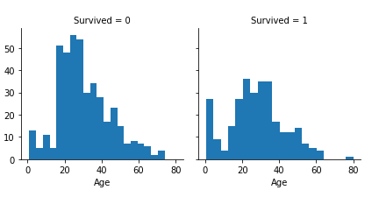
Analyze by visualizing data
Notes:
Infants (Age <=4) had high survival rate.
Oldest passengers (Age = 80) survived.
Large number of 15-25 year olds did not survive.
Most passengers are in 15-35 age range.

Slide 19
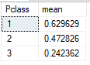
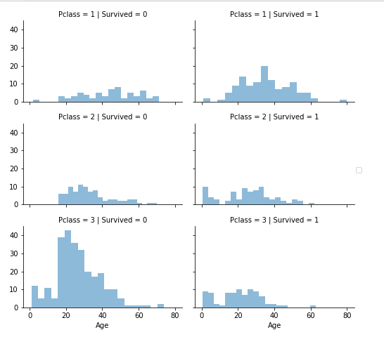
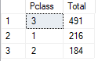
Analyze by visualizing data
Notes:
Pclass=3 had most passengers, however most did not survive.
Infant passengers in Pclass=2 and Pclass=3 mostly survived.
Most passengers in Pclass=1 survived.

Slide 20
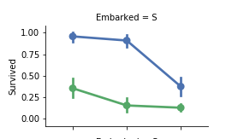
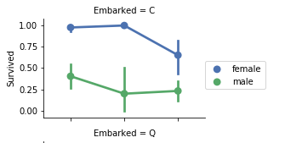
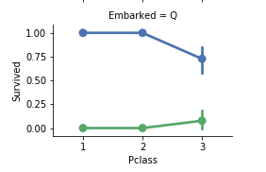
Analyze by visualizing data
Notes:
Female passengers had much better survival rate than males.
Ports of embarkation have varying survival rates for Pclass=3 and among male passengers

Slide 21
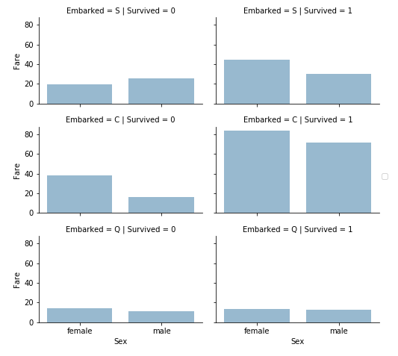
Analyze by visualizing data
Notes:
Higher fare paying passengers had better survival. Confirms our assumption for creating fare ranges.
Port of embarkation correlates with survival rates.

Slide 22
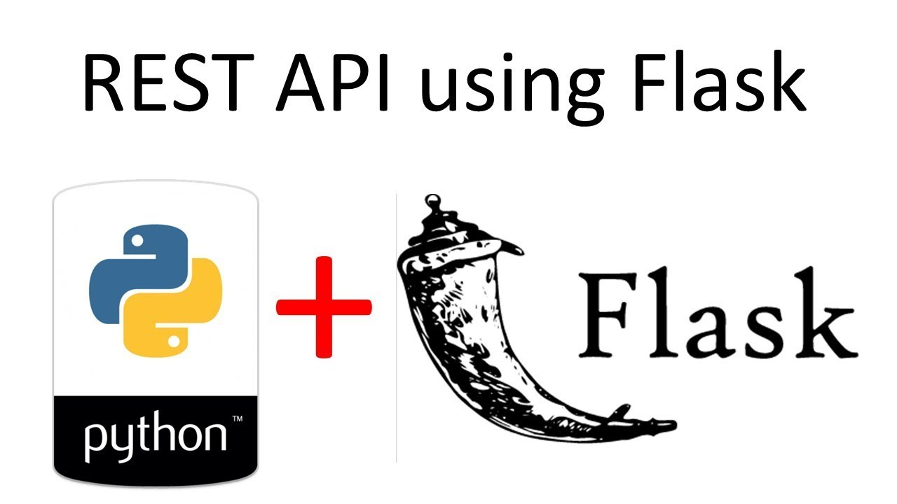
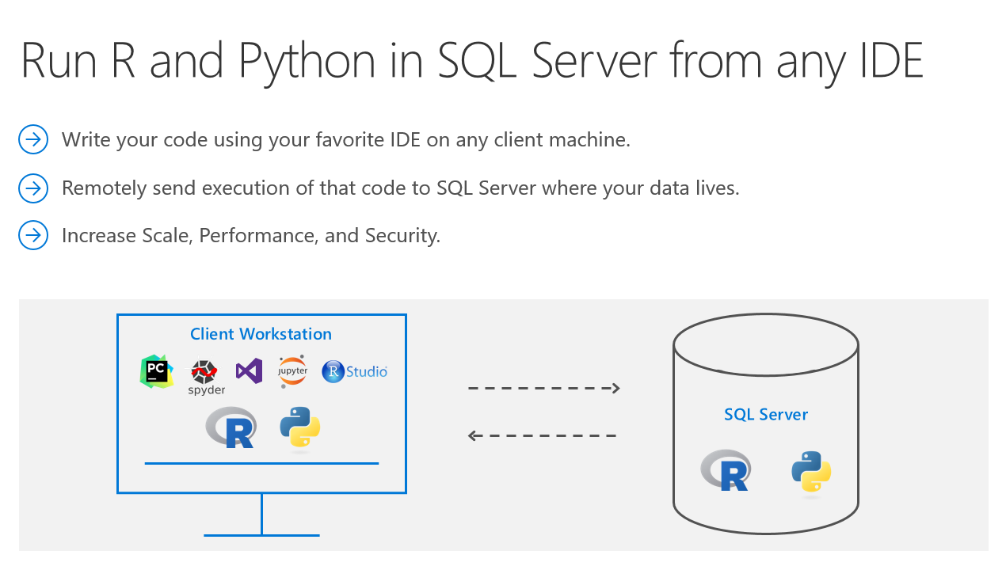

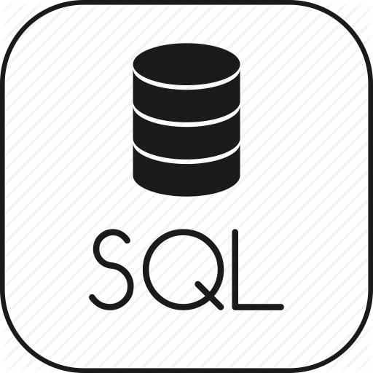

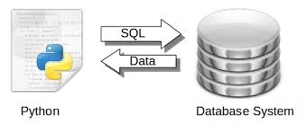

Machine Learning Services
Rest API using Flask
Why Python in SQL
Is it SQL in Python ?
I can use SQLAlchemy ?
Run external script
Notes:
Why should I use python in SQL?
Is it SQL in python? I could use SQL alchemy and query the database? Why I need to learn or explore something new
Yes its python in SQL, executing external script
How to deploy your machine learning project? I need to learn a flask? API?
Why not just put the code inside SQL and run it since data is already there
Can create .net application for example and run
Someone can say, ok I am a python developer why I should learn SQL, I can import it through SQL alchemy and analyze it. And this is the second benefit? Scalability, u have 100GB of database, loading it into your Jupyter notebook and analyze it, I will blow your machine RAM/CPU for playing around the data
The data if it’s truly SQL, can’t be copy, can’t analyze data efficiently
https://www.google.com/imgres?imgurl=https%3A%2F%2Fdocs.microsoft.com%2Fen-us%2Fsql%2Fadvanced-analytics%2Fmedia%2Fml-service-value-add.png%3Fview%3Dsql-server-2017&imgrefurl=https%3A%2F%2Fdocs.microsoft.com%2Fen-us%2Fsql%2Fadvanced-analytics%2Fconcepts%2Fextensibility-framework&docid=R2XuMMu-0_qwEM&tbnid=jrdfTA1Kwmgf2M%3A&vet=1&w=372&h=208&bih=923&biw=958&ved=2ahUKEwjpzNK1pNbkAhWky4UKHYilDDoQxiAoBXoECAEQIQ&iact=c&ictx=1#h=208&imgdii=xS1jQJfD19zncM:&vet=1&w=372
https://pythonspot.com/tag/sql/

Slide 23

Scalability & Speed

Slide 24
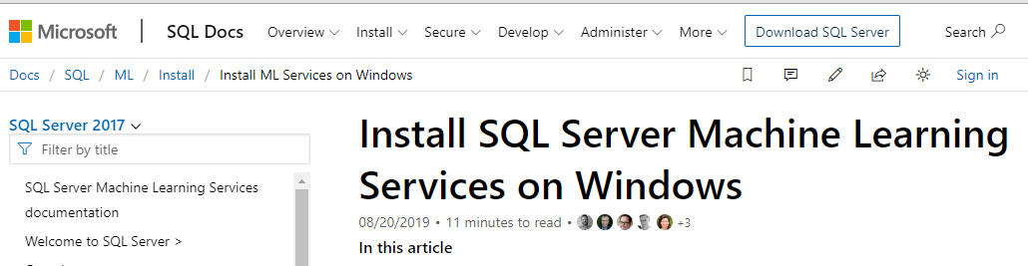
Using Python Inside SQL
Eliminate data movement
Easily operate Python code inside SQL
Achieve enterprise grade performance and scale (much faster mechanism than ODBC)
Notes:
So the huge benefit is the ability to stay within your preferred IDE, connect to a SQL Server instance and do the computations on the SQL Server Machine. So no more clunky data transferring! To address the second point – operationalizing a Python model/script is as easy as calling a stored procedure. So any application that can speak to SQL Server can invoke the Python code and retrieve the results. Awesome!

Slide 25
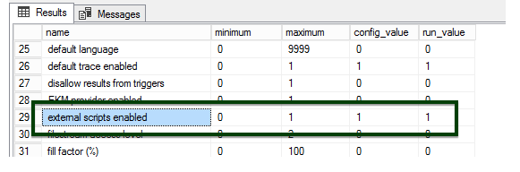
Configuration
To enable SQL Instance to run Python scripts:
sp_configure
EXEC sp_configure 'external scripts enabled', 1
RECONFIGURE WITH OVERRIDE
Notes:
https://www.mssqltips.com/sqlservertip/4747/sql-server-spexecuteexternalscript-stored-procedure-examples/

Slide 26
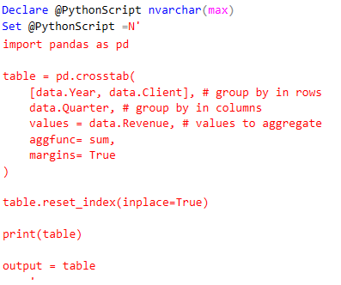
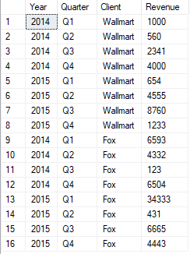
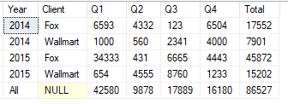
Execute External Script
EXECUTE sp_execute_external_script
@language = N'Python'
, @script = @PythonScript
, @input_data_1 = N'SELECT CONVERT(VARCHAR, Year) AS Year, Quarter, Client, Revenue FROM Sales;'
, @input_data_1_name = N'data'
, @output_data_1_name = N'output'
WITH RESULT SETS ((
Year NVARCHAR(10),
Client NVARCHAR(10),
Q1 INT,
Q2 INT,
Q3 INT,
Q4 INT,
Total INT
));

Slide 27
Machine Learning
Notes:
https://www.google.com/search?rlz=1C1CHBF_enLB766LB766&biw=1920&bih=937&tbm=isch&sxsrf=ACYBGNSM7ln_2XVFs9nxdkYizXLgA_uFvQ%3A1567720951135&sa=1&ei=94VxXf70B4rEgQazwJ2oBg&q=dba+icon&oq=dba+ico&gs_l=img.3.0.0.110663.112391..114221...1.0..0.170.1256.0j8......0....1..gws-wiz-img.......35i39j0i67j0i24.oo0UdZr6Bn0#imgrc=_

Slide 28
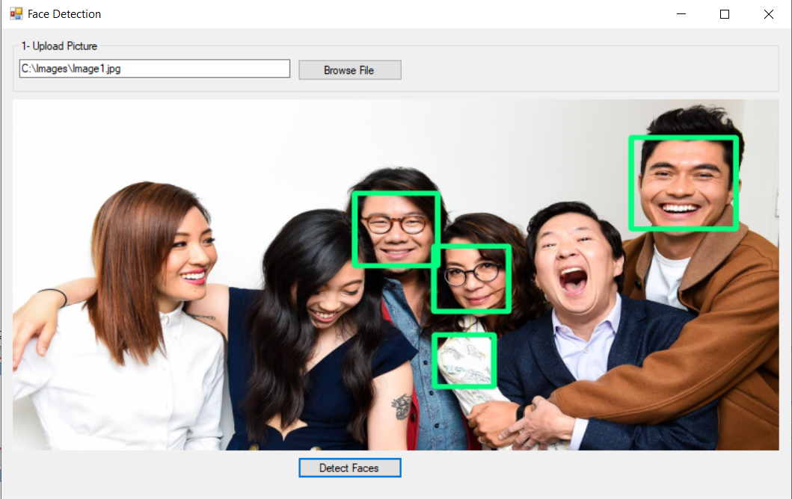
Build AI App in 10min

Slide 29


Who am I?
Samer Salameh
Senior Data Engineer & Business Analyst
Data Scientist

Slide 30
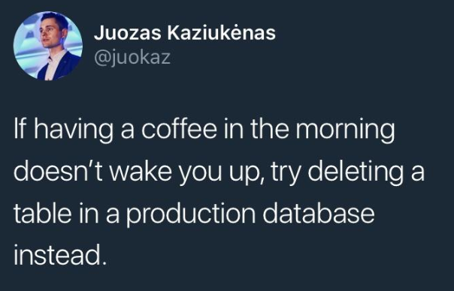
How to wake Up in the Morning

